Slide 1
Understanding and Implementing Positive Behaviour Management for Children with Autism
Singapore Association of OT (SAOT) paediatric special interest group Friday May 6 2016
Dr. John WORTHINGTON

Slide 2
OVERVIEW
Brief overview of Autism and the DSM-5 diagnosis and range of severity
Description of the range of severity and how the behaviours present and their impact
Caution about inadvertent labelling / diagnosis when talking with parents (and others)
Case Study Jim
Indicative Table of Some ASD Characteristics Consequences and Challenges
The general concept of functional behaviour assessment (ABC) and the particular challenges and differences related to ASD.
Considering overall behaviour with the idea of using pre-emptive and preventive approaches to change or reduce certain behaviours.
Questions

Slide 3
Your Experiences
To help me ‘tune in’ to your thinking about the topic, please tell me about your experiences and the types of behaviours you have encountered with children on the spectrum.
Who was most impacted by these behaviours?
Generally what strategies did you find most helpful?
What more do you think you need to know to be more effective in supporting children on the spectrum?

Slide 4
Brief Overview of Autism
Autism is a complex persistent disorder which causes significant impairment that can however can be masked by learned or other compensatory strategies. The features which we are familiar with include difficulties with; social communication, sensory sensitivities, interactions and reciprocity, non-verbal communication and establishing and maintaining relationships. Also present can be variations of repetitive behaviours, restricted interests and difficulties with change and a desire for sameness.
Individuals on the spectrum can also have other significant disorders including intellectual disability and or language impairment, there can also be motor defects (e.g. atypical gait, clumsiness), self-injury (e.g. biting, head banging). Older individuals are more likely to have depression and suffer anxiety.

Slide 5
Severity and How the Behaviours Present and Impact on Children 1
Most of us have a sense of what ASD is.
Our view is based on our reading, experiences and our contact with people on the spectrum. But once you know one person with ASD, you only know one person with ASD.
The range of presentation is very wide, from extreme in terms of limited ability to function and interact in what might be considered a ‘neurotypical’ way.
These children need help to minimise self-harm, reduce the impact of sensory overload, having some elements of two-way communication, allowing mobility, provide the opportunity for choice and identify and expand positive experiences.

Slide 6
Range of Severity and How the Behaviours Present and Impact on Children 2
Children who are impacted to a much lesser degree may at first present with little that seems out of the normal.
However for children with less obvious behaviours it is essential to spend time with them to gain an understanding as to what lead to their diagnosis.
Despite seeming to have more appropriate skills and more generally acceptable behaviours, these children may experience extreme anxiety regarding social interactions, transitions, change to routines etc. They may ‘hold it together at school’ (mostly) and fall apart when they get home.

Slide 7
Caution about Inadvertent Labelling / Diagnosis
Like all of us, parents search the WWW for information and in an effort to understand their child, so it is vitally important for professionals to be considered and appropriate with the words they use when interacting with parents, carrying out therapy, undertaking assessments and making formal records.
These words can have a major impact. This impact can be significant and very positive for children and their families but also has the potential of being negative and further burdening the parents.
Your words and actions and what those words and actions imply need to reflect your confidence, professionality and knowledge.
It is a demanding professional responsibility to be the individual (or part of a team) considering and making a formal diagnosis of an ASD.

Slide 8
What are Your Experiences with Children with more Extreme behavoiurs
Specifically what were the challenging behaviours you observed?
What underlined your approach to making changes?
Who were the key people involved?
Were your strategies aimed at preventing / avoiding behaviours or reacting to behaviours.

Slide 9
Case Study Jim 1
Jim is now an adult whom I met about 15 years ago. In the ten or so years I knew him he displayed a range of extreme behaviours which restricted his life and that of his parents to a very great degree. Supporting his parents to help manage his behaviours was a major challenge. Throughout the focus was in reducing self-harm, introducing basic self-care, having reliable communication, providing choice and improving his life experiences.
In addition to his ASD type behaviours, Jim was deaf, non-verbal (except for some very occasional words) and presented as severely intellectually impaired. While my initial contact with Jim was to try to administer some formal assessments, it became clear that even on a ‘good’ day it was not possible to engage him in any meaning full way. He would need a lot encouragement to sit at a table, he could not focus on basic pictures or objects and at best he would mimic actions and copy words with some word type utterances.

Slide 10
Case Study Jim 2
In helping Jim at each consultation (approximately 6-9 months apart) I would first update the history by talking to his mother and teachers and therapists. Next I would observe him at home, in the outdoor environment and in his classroom, where over the years he moved through a range of regular and special school settings before being home schooled.
In talking to those caring for him I would identify and confirm priorities to make Jim’s life better and those things which would help the individuals looking after him on a day to day basis.
The types of issues dealt with including regulating his toileting, reducing his agitation when travelling, improving his evening routine.

Slide 11
Case Study Jim 3
Despite presenting as an individual with severe intellectual impairment Jim had some remarkable abilities which centred on his very strong attractions to seeing and making patterns.
While he appeared to have no connection to letters or words or even drawings or pictures his strong interest in particular movies / TV shows meant he could very reliably choose a particular DVD from a selection of several hundred.
In addition when he opened the case he knew instantly if the correct DVD was in the box.

Slide 12
Case Study Jim 4
A second area of great concern for Jim’s parents was his extremely poor sleeping, he would resist going to his bedroom, destroy the room and finally after many hours end up exhausted sleeping on the floor. In visiting the home and taking a history of a typical night’s routine and observing that routine there were some unusual features.
In particular while Jim ate with his mother and the help of one of his carers his father usually arrived home late. As it got later and Jim became more tired he also became agitated waiting for his father. When his father did arrive he would talk to Jim through the door. This apparently innocent interaction got Jim more and more excited until finally his father would come in and they would excitedly greet each other. Of course this was also the time Jim was then expected to settle and go off to bed and sleep.

Slide 13
How did I help manage these the challenging behaviours?
We used Jim’s desire to do basic sorting to teach him to make choices (initially between two options). This helped slow down his tendency to just reach out and grab things and allowed him to have some control about food and clothing.
Because he was observed to be more settled when watching his favourite videos the major safety difficulties in vehicles was to a great extent resolved.
We used favoutite objects to teach him to direct his gaze to particular targets.
We changed the night routine so that Jim’s dad came in when it was quiet and he and Jim did some preferred quiet tasks before bedtime.

Slide 14
Some ASD Characteristics consequences and challenges
Diagnostic Criteria / Characteristic | Resulting behaviour / consequences | Management Challenges | Other Factors
Complex disorder | Society in general is based on a neuro-typical view of the world, individuals with ASD have a different world view. | Acknowledging the child has a different world view which may well be the cause/s of a particular behaviour. | Behaviour may be unrelated to ASD e.g. health, sleeping, ADHD, anxiety
Persistent disorder | Characteristics will tend to persist, moving behaviours from the negative / damaging time consuming characteristic to be more positive productive | Observing and understanding the behaviour and using that to guide change (e.g. make lining up more useful) then move on to other generalizable tasks. | Parents , teachers, therapists and others needing to understand the underlying persistent nature of ASD and its impact Awareness → Understanding → Action

Slide 15
Diagnostic Criteria / Characteristic | Resulting behaviour / consequences | Management Challenges | Other Factors
Social awareness and communication | Poor or incorrect reading of social cues. Preference for reduced or no social interaction. At risk of bullying. | Teaching social communication to broaden social contact. Not forcing the child to do things they are not ready for. Deliberate use of language, provide language modelling and adequate time to respond. Opportunities for sharing in semi-structured activities, one-to-one or in small groups. Teach how to read facial expressions. | Using other strategies such as social media to facilitate social awareness and communication. This could be the end goal or a step to more direct interaction.
Sensory Sensitives | Sensory seeking or avoidance leading to; social isolation and perceived difference and interrupted learning and recreation. Social consequences if unable to do some social things e.g. touch / shake hands. | Identifying the sensory profile of the child. Reducing the impact of the sensory sensitives through manipulation of the environment, appropriate diversion and or de-sensitising. Such as appropriate seating, quite areas, less clutter, fewer distracting materials. | Changing the environment without isolating the child.

Slide 16
Diagnostic Criteria / Characteristic | Resulting behaviour / consequences | Management Challenges | Other Factors
Issues with Reciprocity | Can lead to social isolation and negative perceptions by others. | Modelling and teaching reciprocity Using social stories to illustrate turn taking. | Can be mistaken for rudeness or social ignorance. Cultural differences, what is seen to be appropriate in one culture may be an issue in another.
Repetitive behaviours | Can be time consuming and avoidant. Non-productive but may be an escape. | Identifying the nature of the repetitive behaviour as it presents and using it to inform learning. | Allowing the child to engage in repetitive behaviours at and for appropriate times, possibly as a reward.

Slide 17
Diagnostic Criteria / Characteristic | Resulting behaviour / consequences | Management Challenges | Other Factors
Restricted interests, preoccupation with interests | Can be socially isolating (from neuro-typicals), limit learning in broader areas. Occupying time with particular interests may help a child settle and or be used as a reward. | Accept (appropriate) special interests manage involvement to appropriate amounts of time and places. Use the knowledge within the special interest to inform teaching. | Special interests can become a major positive factor in an individual’s adult life in terms of vocation and social connections.
Diagnostic Criteria / Characteristic | Resulting behaviour / consequences | Management Challenges | Other Factors
Issues with change, desire for sameness | Can lead to anxiety and emotional outbursts. Can present as oppositional behaviour. | Can present as extreme situation specific behaviour. Event should be used to inform future planning to avoid the same situation, teach signalling (child indicated they are getting anxious) Develop strategies for managing anxiety | While there are some things which must happen (e.g. fire evacuations) – practice regularly, give warning of a drill. Most things can be manipulated to accommodate a particular child’s needs at a particular time.

Slide 18
Diagnostic Criteria / Characteristic | Resulting behaviour / consequences | Management Challenges | Other Factors
Possible associated issues, learning difficulties, intellectual ability, language disability, motor differences | Slower academic learning, poor receptive and or expressive language, difficulties with skills such as handwriting. | Include a visual emphasis, simple drawings and symbols to show order and direction. Social Stories
Emotional issues, anxiety, (later depression) | Displays of anxiety impacting on functioning. | Recognition of the cause, strategies to reduce symptoms, teach relaxation/mindfulness. Use Social Stories to explain what will happen and preview situations which will be different.

Slide 19
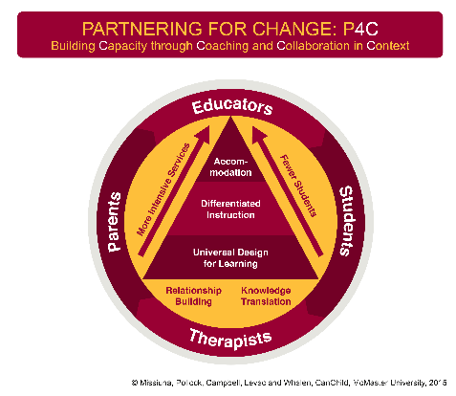
Conceptualizing the Nature of Making Changes for an Individual
One of the main points of resistance to accommodating the needs for children on the spectrum and other children with special needs, is that those changes (often in the form of recommendations from outside the school) will somehow disadvantage other children.
It is true many children on the spectrum may require a different approach, more direct support and more time of the teacher or support staff, however it is seldom the case that the accommodations will only benefit the target child.
In fact when most recommendations often sound like good teaching practice and fit easily into the a Universal Design for Learning (UDL) Tier 1) ‘good for all and essential for some’.

Slide 20
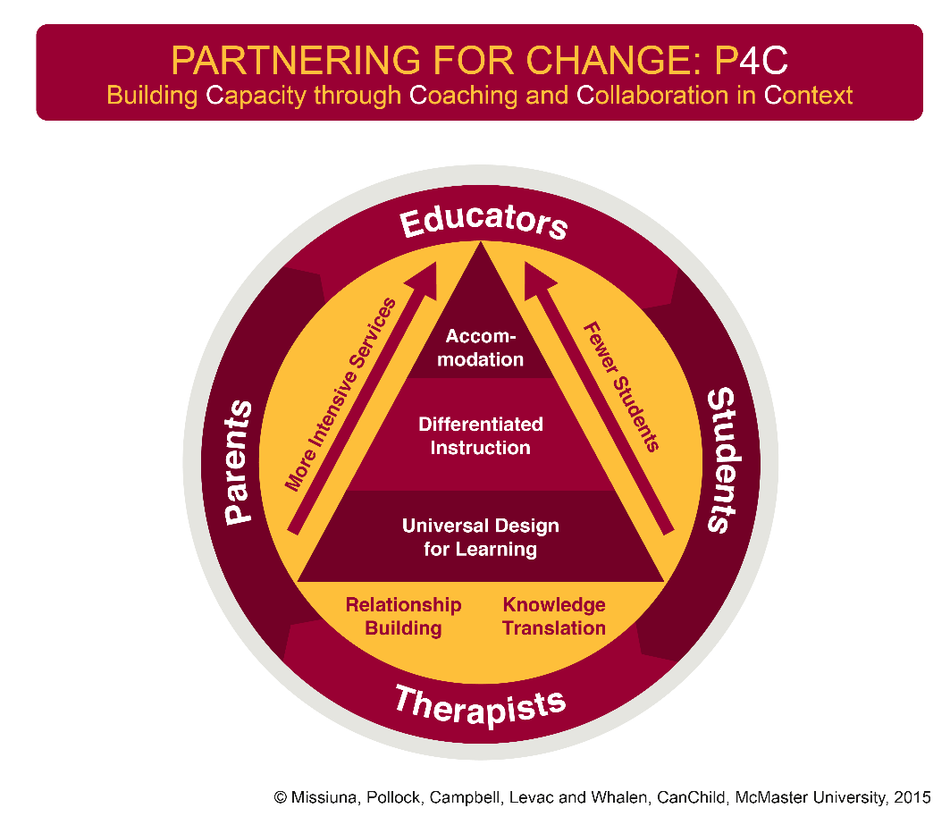
The next level (Tier 2) Differentiated Instruction, where the teacher / therapist targets the needs of individual students. These small group or individual activities may be needed due to the child having such things as a lack of practice / experience or opportunity to ‘learn’ a particular task or developmental need.
The highest level of support and intervention Accommodation (Tier 3) is for those limited number of children who have more complex needs.

Slide 21
Behaviour Management and the Particular Challenges for Children on the Spectrum
The well-known Antecedent-Behaviour-Consequence or ABC is appropriate to conceptualize management.
This is the basis of functional behaviour analysis
However a longer term approach needs to be taken and each of the three parts needs to be considered in light of the additional things drive an ASD child.

Slide 22
Over time …
These ‘differences’ can be linked to the features which have led to the diagnosis in the first place.
Restricted interests and difficulties will change
Social communication typically improves
Social interaction and reciprocity often improves when individuals learn the ‘rules’
Establishing and maintaining relationships
Repetitive behaviours tend to get worse with anxiety
Sensory sensitivities may improve but rarely ever go away

Slide 23
Antecedents (Before)
In behaviour management it is always necessary to consider what might be termed the ‘basics’ such as; is the child well (ear infections, headaches), have they had adequate appropriate sleep (how long since they woke up), have they eaten, are they physically tired, have they had any ‘screen time’, are there any disruptions in the home situation (parents relationship).
There could be issues which could be linked to the child’s ASD style/temperament. For example has there been any change to the routine of the day (home, school or elsewhere), has there been a difference in such things as; new people or people in different places, time or timing of particular activities, lighting, seating, temperature, breezes, issues with clothing. Has the child been in a different social situation (new children or adults to deal with) or experienced bullying.

Slide 24
Behaviour (During)
ASD children can do some things differently, when feeling anxious (e.g. about an unexpected change) they may want to ‘hide’ under a desk and refuse to come out. They may become disproportionally distressed by an apparently small issue. When considering the observed (or reported) behaviour it is necessary to consider the link to antecedents. This is because an ‘outburst’ of apparently oppositional behaviour may in fact be the result of something that is very significant to the child but not obvious to the observer.
If the child’s behaviours are being formally evaluated it is important to not only describe the behaviour but the overall environment (physical, temporal, social, communication) and emotional) in which that behaviour occurred.

Slide 25
Consequence (After)
Knowing what went on after the behaviour for the child and others can provide vital clues to inform intervention and prevention. In particular what transpired up until the child returned to their typical / calm behaviours.
What, if anything was done to or for the child, and did the child initiate or try to initiate a ‘exit’ from the behaviour.
Is the child’s recovery related to hyper (heightened) or hypo (dampened) sensitivity of some kind.

Slide 26
Pre-emptive and Positive Approaches to Change or Reduce Behaviours
Behaviour is by its nature variable and developmental, however once a behaviour or a pattern of behaviours is described and analysed it may be possible to manipulate the situation, reduce certain behaviours and encourage other behaviours.
As changes are made careful observations of the effect of those changes needs to occur.
Such changes can relate to the child’s sensory environment, social environment, the timing, mix and order of activities, the rate and type of communication and the demands on the child.

Slide 27
Positive and Generalizable
While some children (and adults) may have behaviours which appear intractable (Jim), positive approaches can be used to manage virtually all behaviours (Positive behaviour supports)
In addressing extreme behaviours assuming the trigger issues have been identified and addressed as much as is possible, it could be that providing physical protection (helmet) and or a safe environment is required.
Jim was very engaged by lining things up, this was used to teach him to choose from two types of objects (e.g. red and blue blocks). In time the skill of choosing was extended such that Jim was able to make choices between food types, DVDs and clothing.

Slide 28
Focus on Positive and Strengths
For most children a positive approach will be effective in reducing the behaviour of concern or modifying the behaviour to something benign or even useful.
Recognise useful elements in behaviour and follow the child’s lead.
Extinguishing a particular behaviour can be very difficult and time consuming; even if the process is ‘successful’ it is likely another behaviour will arise.
Following the lead of a child as they begin to interact with their environment can be an opportunity to communicate (verbally and socially), extend the child’s experiences (using new materials or using materials in a different way) model skills such as turn taking.
Use special interests and link to the curriculum - the ASD child will be more than able to focus and elaborate and learn.

Slide 29
Questions and Discussion
References:
Montgomery, R.W. (2004). Behavior-Consultant.com - ABC Data Collection Form
www.behavior-consultant.com/ABC%20-%202%20page%20form.pdf
Caron, M.J., Mottron, L., Berthiaume, C., Dawson, M. (2006) Cognitive mechanisms, specificity and neural underpinnings of visuospatial peaks in autism. DOI: http://dx.doi.org/10.1093/brain/awl072 1789-1802 First published online: 5 April 2006
American Psychiatric Association. (2013). Diagnostic and Statistical Manual of Mental Disorders 5th Edition, Washington DC: American Psychiatric Publishing.
Dodd, S. (2005) Understanding Autism, Sydney: Elsevier.
Marie, Ed.D. (2002). Supporting the Twice-Exceptional Child. http://psychcentral.com/lib/autistic-and-gifted-supporting-the-twice-exceptional-child.
Kluth, P. (2003), You’re Going to Love this Kid – Teaching Students with Autism in the Inclusive Classroom. Baltimore: Brookes.
Missiuna, C.A., Pollock, N.A., Campbell, Levac, D.E. and Whalen, S.D.. Partening for Change (P4C). CanChild, McMaster University, 2005.

