Slide 1
The Role and Challenges of IQ Testing in Understanding and Supporting Individuals with Autism Workshop for Center for Creative Initiatives in Health and Population (CCIHP) 24 January 2018
When is a KitKat not a KitKat?
Dr. John Worthington MAPS MSPS
Educational Consultant and Psychologist
E-mail: info@jweducation.com Web address: www.jweducation.com

Slide 2
Overview
Introduction
Initial Questions
Ethics before Effort
The Place of Cognitive Assessments
The Limitations of IQ Testing in ASD
A Brief overview of the history of IQ testing
What do IQ tests Look Like
What do IQ tests Measure
What do the Results Look Like
A Cognitive Assessment Can Reveal Far More than More than Numbers
Lets have a break
IQ testing in the ASD Environment
Case Study
The Kit-Kat Phenomena
Reporting Multiple Result Types
Questions and Discussion

Slide 3
Do you have any Questions?
Staying flexible
Your questions
Limitations
From my perspective

Slide 4
Ethics before Effort
The ethical issues in assessing ASD individuals with instruments developed for the general population, limitations of (any) testing. Assessing any individual with cognitive instruments should only occur after considering the benefit to the child and any possible negative impact. This consideration for children (and adults) with ASD needs particular attention as a ‘failed’ assessment will give no useful information and may also prevent or delay any future attempts.
Just because you can do an IQ test doesn’t mean you should.

Slide 5
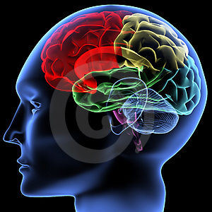
The Place of Cognitive Assessment
While the ‘needs’ and ‘rights’ of people are universal, understanding the rights and needs of an individual with Autism requires particular consideration. IQ tests form one type of tool used to help us understand the learning potential and learning style in individuals generally.
However because individuals with ASD have a different way of thinking and understanding the world around them, great care must be taken when deciding to use IQ testing and, when used, how results should be interpreted.

Slide 6
Alternative Diagnosis and IQ
Individuals who present with atypical behaviours which suggest ASD may be responding to other issues.
They may not have any significant disorder and their behaviours have been perceived by parents or others incorrectly.
They mat have ‘learned’ ASD type behaviours from siblings or peers.
They may be intellectually gifted and their strong interests and or repetitive behaviours are reflection of their exceptional ability and ability to focus.

Slide 7
ASD Diagnostic Considerations
Input for Diagnosis and Support
Clinical
Observations during Assessments
History Prior to Presentation
Reports and Records (Parents Teachers and Carers)
Other Assessment
Findings
Intellectual IQ
Behavioural ABAS-III
Academic Skills (Psychologist)
ADOS-2 Direct diagnostic tool
Language (SLP)
Physical Health, Development
and Performance
(GP Paediatrician OT Physio)

Slide 8
What Next
History
Clinical Observations
during Assessments
Individual Program Development and Implementation
ASD Diagnostic Considerations
ADOS-2 Results
Language Assessment Results and Programming
Physical Development
and Performance
Intellectual IQ
Behavioural ABAS-III
Academic Skills
Observational Questionaries
Program Evaluation and Refresh

Slide 9
The Limitations of IQ Testing in ASD ADOS-2 Vs IQ Assessment
It is important to remember IQ testing is not designed of use with individuals with ASD as a definitive part of diagnosis but an Iq assessment can provide a valuable addition to other assessments such as the ADOS-2.

Slide 10
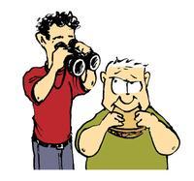
The Autism Diagnostic Observation Schedule - Second Edition (ADOS-2)
The Autism Diagnostic Observation Schedule - Second Edition (ADOS-2) is a semi structured, standardised assessment of communication, social interaction, play, and restricted and repetitive behaviours.
By observing and coding these behaviours, clinicians can obtain information that informs diagnosis, intervention, treatment planning, and educational placement.

Slide 11
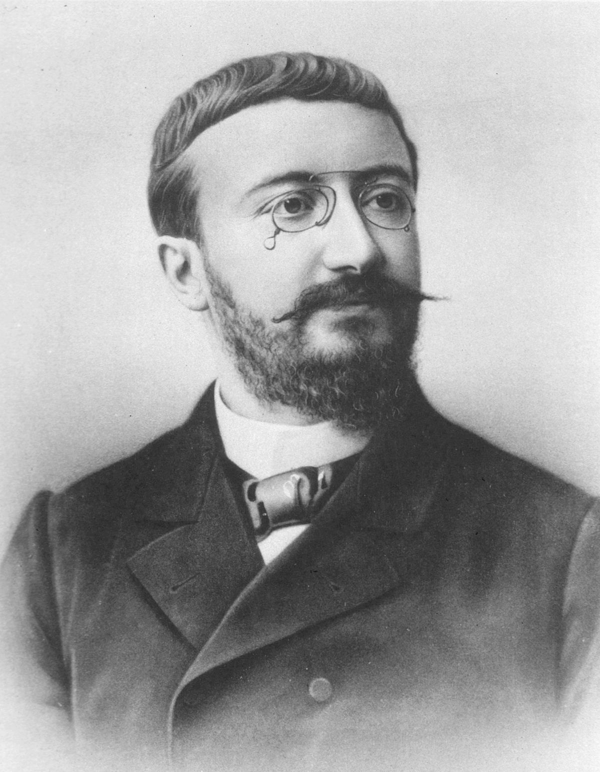
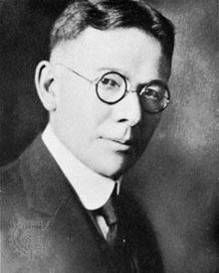
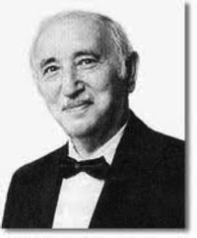
A Brief Overview of the History of IQ Testing
Putting IQ testing in context.
These tests developed and evolved over 100 years now represent the gold standard of psychometric properties and have direct links to the original WISC (Wechsler, 1949) and the Stanford-Binet announced in April 1905 and introduced in June 1905, with the more familiar version published by Terman in 1916.
Alfred Binet (1857-1911)
Lewis Terman (1877-1956)
David Wechsler (1896-1981)

Slide 12
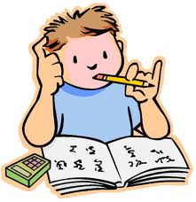
What do IQ tests Measure?
The long history of research and ongoing review, I believe brings us to a point where testing an individuals cognitive ability (IQ) is accepted by most people.
Good IQ tests measure aspects of visual-spatial processing and auditory processing, as well as short-term memory, and processing speed.
More over the results as reflected in the scales and distribution of scores are one way to help understand an individuals general cognitive problem-solving skills typically reflected in academic learning and potential.

Slide 13
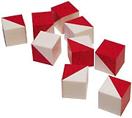
What do IQ Tests Look Like
IQ tests are typically made up of a number of sub-tests (e.g. the WISC-V has 16 in total) with a core number given and additional options available. In turn these subtests are combined to form Index scores (e.g. five in the WISC-V) with some or all of the subtests then contributing to and overall result often referred to as an IQ or Full Scale Score. Several IQ tests can now be done at least in part on a tablet.

Slide 14
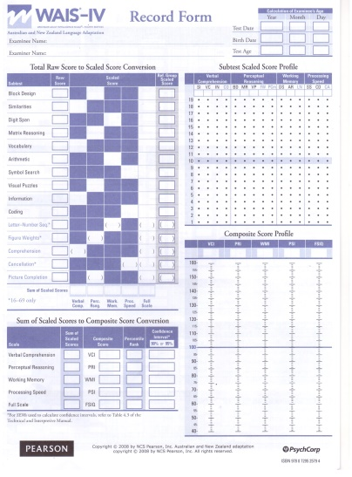
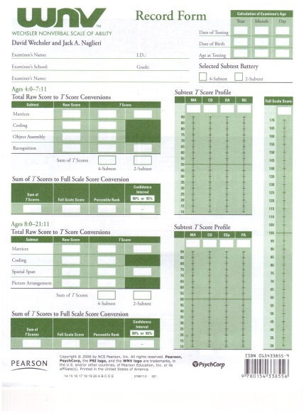
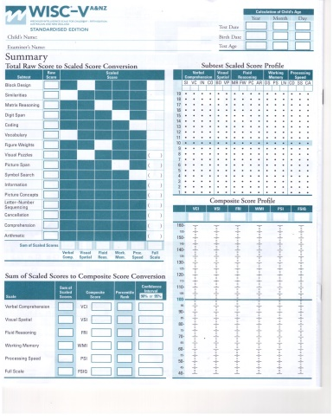
Samples of some IQ Tests
WISC-V
WAIS-IV
WNV

Slide 15
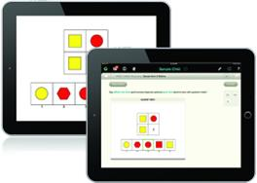
WISC-V
Wechsler Intelligence Scale for Children - Fifth Edition (WISC-V; Wechsler, 2014) with the Australian and New Zealand standardized version released in 2016.

Slide 16
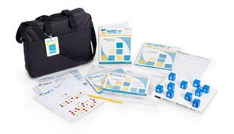
Wechsler Nonverbal Scale of Ability (WNV) (2006)Weschler D. & Naglieri J. A. (2006)

Slide 17
What do the Results Look Like
Index scores and the Full Scale IQ Score which include "Extremely High” 130 and above, “Very High” 120-129, “High Average” 110-119; “Average” 90-109 and “Low Average” 80-89, “Very Low” 70-79 and "Extremely Low" 69 and below.
The standard deviation is a measure of spread, in this case of IQ scores. A standard deviation of 15 means 68% of the norm group has scored between 85 (100 – 15) and 115 (100 + 15). In other words, 68% of the norm group has a score within one standard deviation of the average (100).
The results of subtests can also be shown as age equivalents, i.e. the age at which a typical individual would perform at that level.

Slide 18
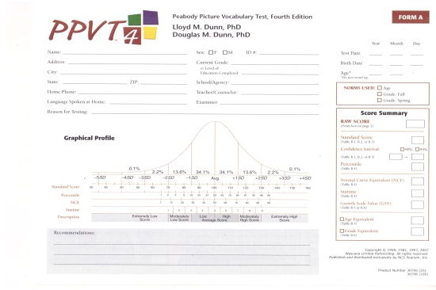
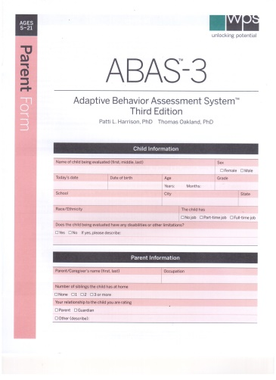
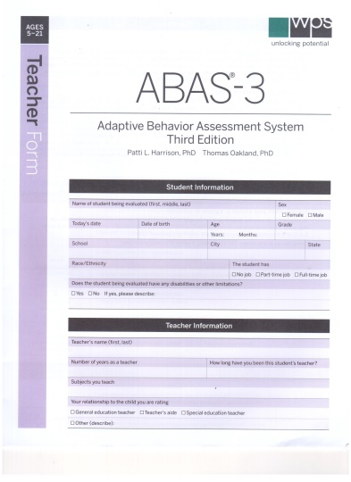
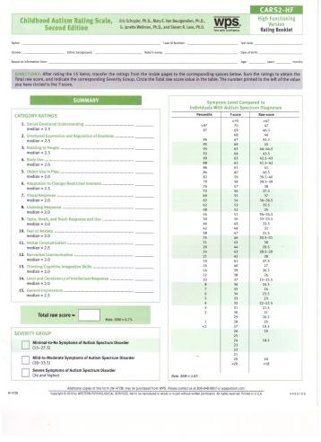
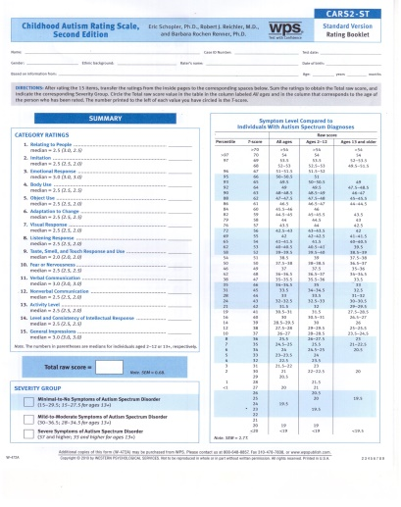
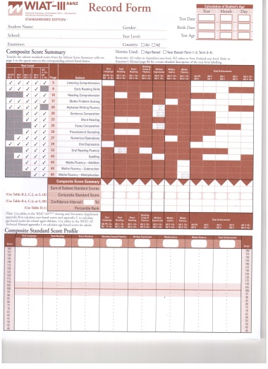
Associated Assessment Tools
PPVT-IV
ABAS-III Parent
ABAS-III Teacher
CARS-II HF
CARS-2 ST
WIAT-III

Slide 19
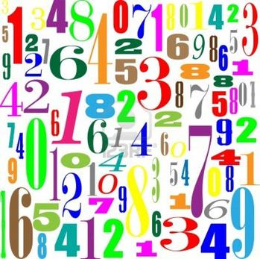
A Cognitive Assessment Reveal Far More than More than Numbers
The ‘standardized’ nature of IQ testing does present challenges when working with individuals with ASD however the process of assessment also provides a basis for a wide range of clinical information to be gathered about the child’s affect, attention, interests and sensitivities, task persistence, expressive and receptive language, fine motor functioning etc.

Slide 20
Time for a Break

Slide 21
IQ testing in the ASD Environment
Provide an overview of the place of IQ testing in the ASD population as one tool in understanding abilities and thinking styles.
Individuals thought to have ASD or who have been formally diagnosed may not have had their IQ assessed. While there are individuals whose behaviours are so intrusive that formal (i.e. standardized) assessment is not possible it is my view that the cognitive capacity most individuals can be assessed in whole or part using a range of tools including IQ tests.
While the effort may be great an appropriate assessment of cognitive and other skills can provide a window onto the individual’s strengths and weaknesses, inform programming and a further way to monitor development.

Slide 22
Case Study
Dan a four year old child born in Australia whose family moved to Singapore for the father’s work when he was 18 months old.
Dan’s early development was relatively typical except for language delays, however as he got a little older a range of concerns grew about his very limited expressive language, receptive language, limited social interaction skills, changeable behaviours frequent tantrums, hitting, running away, repetitive play and high levels of physical energy and activity

Slide 23
Case Study Context
As a two and three year old Dan’s behaviour was such his parents sought advice from a range of professionals and eventually he was placed in a special private kindergarten program. While at the part day program he received occupational therapy and speech therapy.
When he was referred to me at age 4y 10 months he was still attending the special kindergarten but his behaviours were extreme and at times dangerous to him and or others. His parents growing concern was what capacity did he have to learn and where would be best for him to be schooled.

Slide 24
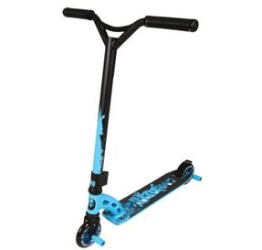
Preparing Dan for an IQ Assessment
Prior to visiting Singapore to do the assessment I had several detailed conversations with Dan’s mother. In addition to collecting a history I sought to try to understand the nature of his behaviour outbursts and under what circumstances was he more settled.
This preparation proved to be essential as Dan was prone to throwing toys and ornaments out of the seventh story apartment window. When outside he was happiest but deliberate rode his scooter into the ornamental fish pond.
By arrangement with the mother and over a few weeks she built up his ability to sit at a table and do table top tasks. We also considered his sleeping patterns, the temperature, noise levels and visual and other distractions.

Slide 25
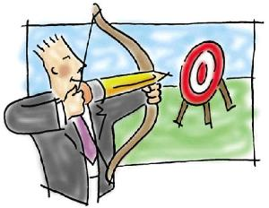
Aim of the Assessment
The general aim of the assessment was to establish base lines for Dan’s capacity and behaviours in a wide range of relevant skills. The information was gathered by observing Dan interacting with his parents and siblings in a range of settings (indoors & outdoors) as well as observing him doing a range of cognitive, and other tasks.
While adhering to the guidelines and consistency is at the heart of IQ testing this is often an issue when assessing ASD children. Sometimes during testing certain allowances need to be made in order to achieve a result. When reporting the results where changes were necessary those changes need to be detailed both for accuracy and for the information of future assessors.

Slide 26
The Kit-Kat Phenomena (A lesson for us all)
As an example of modification (not in the IQ part of the testing) following a consultation with Dan’s mother she provided Kit-Kay chocolate sticks as reward for doing certain amounts of work. This proved highly motivating for Dan until I thought it would be a good idea to break each Kit-Kat up into several small pieces. The moment Dan saw me do this he lost the plot and it took some time to retrieve the situation of ‘not Kit-Kat’.

Slide 27
Reporting Multiple Result Types
Because testing ASD children is likely to result in some reliable results in certain skill areas and some less or unreliable results final scores such as a reliable IQ may not be possible. In these situations in addition to the standard scores discussed in the text I use a Cognitive and Developmental Learning Profile (C&DLP) approach. This is simply a way of reporting on a wide range of results relative to an individual’s Chronological Age (C.A.).
The C&DLP allows for reassessments and different assessments to be added progressive to form a ‘picture’ of the child’s development over time.

Slide 28
Reporting Multiple Result Types Simple Cognitive and Developmental Learning Profile (C&DLP) (Approximate Performance Comparisons)

Slide 29
Complex Cognitive and Developmental Learning Profile (C&DLP) (Approximate Performance Comparisons)

Slide 30
Conclusion
Questions
Answers

