Slide 1


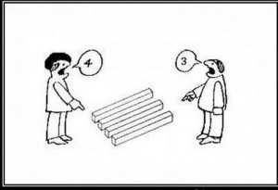
Early Literacy Development: Reality and Perceptions
Dr. John Worthington MAPS MSPS
Educational Consultant and Psychologist
Presentation for MindChamps Saturday 5th October 2016

Slide 2

What is Normal
The vast majority of children come into the world with a remarkable capacity to survive, they are ‘designed’ to learn and adapt from the outset, and in a real sense, our job as parents and educators is to provide and nurture the individual child to enjoy life and reach their potential.

Slide 3

Aims of this Discussion
To give information about the typical progress of early literacy development, in a sense what is ‘normal’, and what you can do to help your child.
Understanding ‘typical’ development and the home activities which go along with it is the first step in ensuring your child’s long term literacy future.
To detail how parents and teachers perceived individual children as they progressed through early literacy and when these two perceptions may differ.
To touch on features which may predict a child could have difficulties in gaining early literacy.

Slide 4


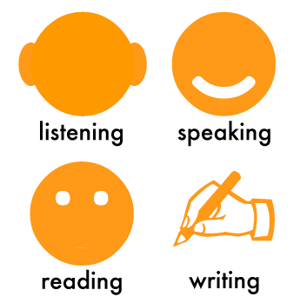
The Road to Literacy
Remember, literacy is the end point of a complex range of learning activities and development: bringing together language skills, cognitive ability, visual skills, attitudes, emotion and personality. As part of this the child needs to be exposed to models of reading behaviour, so that they see: sitting down, holding a book or screen, and reading as a normal and rewarding behaviour undertaken by children and adults alike.

Slide 5


Parental Expectations and Perceptions
Virtually every parent hopes for and expects their newly born child to succeed at school and in particular that their child will learn to read. Fortunately the majority of young children will achieve this goal and will have moved through early literacy by the time they complete Primary 2, are well on their way to being lifelong competent readers.

Slide 6


Early Literacy: Are we there yet?
From the start there can be huge differences between children who will eventually achieve normal literacy.
On the one hand some intellectually bright children, known as ‘precocious readers’ who virtually teach themselves to read at a very early age, while at the other extreme, a small number of children struggle to develop early literacy skills and progress far more slowly.

Slide 7
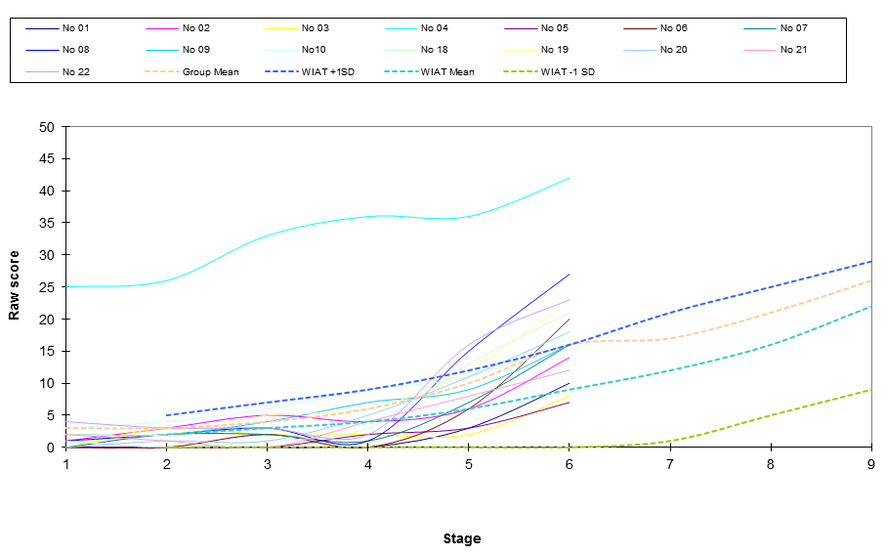
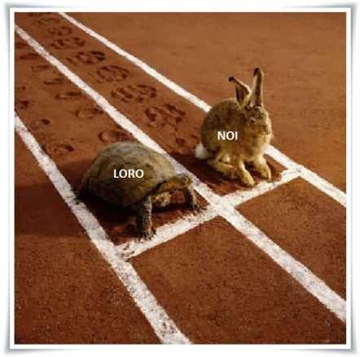
Most Difference is Normal: But!
Figure 1. Basic Reading raw scores for individual children over three years.

Slide 8
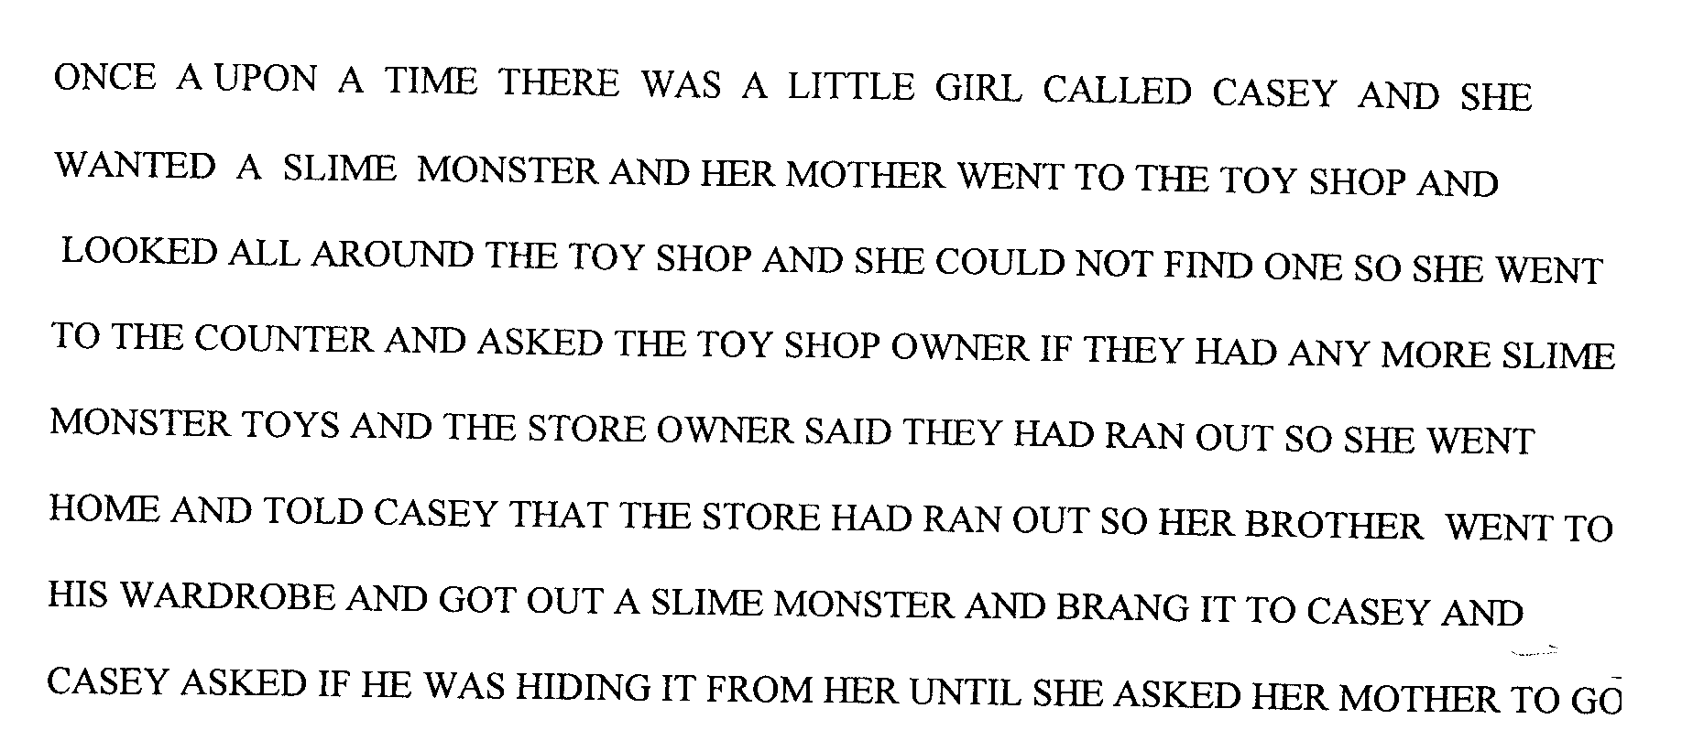

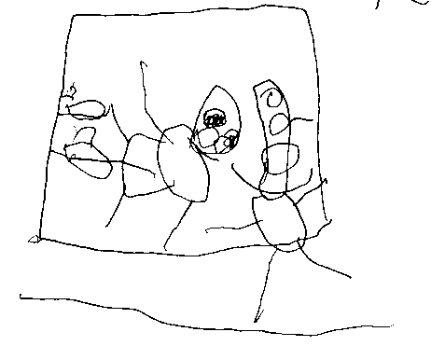
Running Before the Race Starts
Figure 2. Sam’s writing and drawings, early preschool.

Slide 9

Do Parents Worry?
The answer is YES, when we meet our baby child for the first time, one thing upper most in our mind is: are they whole (ten fingers, ten toes and the rest). We bring them home and worry, are they well, are they hungry, are they in pain and so on.
No matter how little or much we have done I terms of engaging and stimulating our child inevitably we start to think about schooling and how you baby will manage to learn.

Slide 10

What is the Saw Tooth Pattern
If there is an issue with your child’s early learning, there is a reason why it may be difficult convincing the teacher or others that something is not quite right. The reason is the Saw Tooth Pattern as illustrated on the next slide.

Slide 11
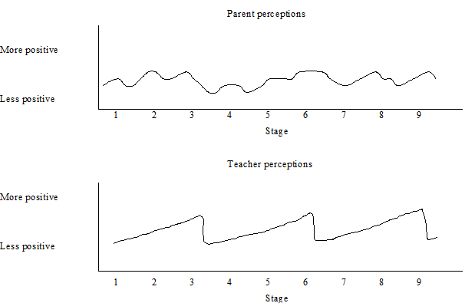

Saw Tooth Pattern
Figure 3. Theoretical model of the how the average perceptions of parents and teachers change over time.

Slide 12
Why do I Have to Learn to Read?
Despite our best efforts some young children do not make the connection between all that is going on with words, books and reading, and why this is all happening around them and ‘to’ them.
Through modelling and real life activities show (and tell) the child why reading is a good skill to learn.

Slide 13



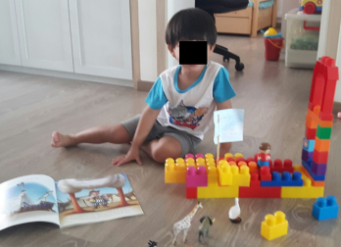
To Do List
Provide an environment at home which includes: time with and without technology, a conscious effort to engaging your child in a range of activities which involve language, images, objects, toys, pets, words, books and people (parents, siblings, peers and others). It is also important to have consistent routines around activities for daily living such as meal times and bed time.

Slide 14

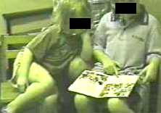
Share the Experiences and Activities
Make exposure to books and literacy activities ‘normal’.
Share the activities around, mum dad, brothers sisters, relatives and friends.

Slide 15


Word Jungle or Word Desert?
In working with young children as a psychologist, I am privileged to be able to visit many homes. As part of those visits I ask to be able to look into the children’s bedrooms. Typically I can instantly classify them as either a ‘Word Jungle’ or a ‘Word Desert’.

Slide 16
Why Is Routine so Important?
Because the early routines set up at home around literacy are difficult to change. Tt is important to establish routines early so that when the child begins to be exposed more formally to reading there is time in the day.
Figure 4. Number of sessions of home initiated reading at home.

Slide 17
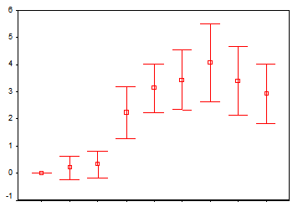
School and Home Reading
Don’t stop reading to your child when they begin to bring books home from school.
Figure 5. Number of sessions of school initiated reading at home in previous week.

Slide 18

Persistence and Engagement

Slide 19

Engagement
While it is important for children to learn how to entertain themselves and be content to find, start and do activities independently, it is equally important to nurture the joint activity of engagement. You will know you have engaged with your child if: you both come to the activity willingly, you interact and participate in a positive, meaningful and productive way.

Slide 20
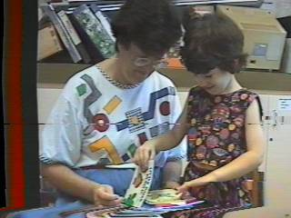
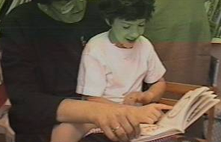
Engaged in Reading
While virtually all children liked to be read to, reading with children can be another matter.

Slide 21
Nurture Resilience
While to a greater or lesser extent we all call on our ability to cope with adversity; young children have limited means to influence their sensory, emotional, social and learning environment. In expecting a young child to keep going we are assuming they can draw on their resilience.
Through the way we ‘help’ then, our aim should be to nurture children to be strong independent learners.

Slide 22

Nurture Persistence
While it can be a double edged sword which cuts both ways, nurturing persistence is essential for a child to keep going and stick with tasks when those tasks are difficult.

Slide 23



The Don’t List
Don’t assume that just because a sibling, you or anyone else found learning to read ‘easy’ that it will be the case for any particular child.
Don’t avoid the teacher, share any concerns you may have.
Don’t spend money on your child, spend time with your child, sharing and showing literacy in action.
Don’t forget the pot plants.

Slide 24

Don’t Forget the Pot Plants

Slide 25

Barriers to Early Learning
While there are no ‘rules’ about who is best to help and advise parents I do suggest the following:
When you as a parent are worried about your child's early learning it is important you share your concerns with your partner and the teacher to get their perspective and advice.

Slide 26


Check the basics: Hearing and Vision
When there is parental concern and or young child is: reluctant to engage in typical social, emotional and early learning activities, that child’s vision and hearing should be formally assessed.

Slide 27
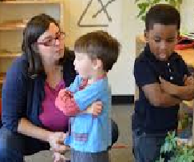
Language
If a child’s understanding of, or memory for what they hear (receptive language) and or what they can say (expressive language) is not typical for their age seek a review by a speech language pathologist.

Slide 28

Learning as an Occupation
Some things which may suggest a review by an Occupational Therapist:
When a child is restless and unable to settle they may have sensory issues (e.g. do you cut the labels off clothing?).
When a child can’t relate to others in a typical way.
When a child has difficulty in skills of daily living (e.g. dressing, eating).
When a child can’t manipulate basic tools (e.g. cutlery, chop sticks, crayons and pencils).

Slide 29

Learning Ability
If there is ongoing concern about a child and no obvious ‘reason’, a cognitive (I.Q.) and learning assessment should be considered.
General Psychologists, and Developmental and Educational Psychologists are skilled at assessment and advising on learning and behaviour issues.

Slide 30
Literacy and the Doctor
If a young child doesn’t appear to want to play and can’t relate to toys in a typical way (e.g. lines up things, doesn’t use his / her imagination).
If the child is: overactive, unable to settle to a task, can’t direct their attention to an activity, is tired in the morning, unwilling or unable to play and or generally ‘unhappy’ they should be reviewed by their medical doctor with a view of a referral to a paediatrician.

Slide 31

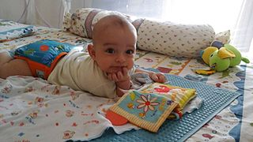

What Have We Covered and Questions
Literacy is the end point of a complex range of learning activities and development
Ensure there is exposure to models of reading behaviour
It is normal to worry
Remember the Saw Tooth Pattern
Early literacy also involves: language, images, objects, toys, pets, words, books and people (siblings, peers and others)
Routine, resilience persistence and engagement
The doctor, paediatrician, occupational therapist, speech language therapist, the psychologist and others
The Pot Plants, the Word Desert and the Word Jungle
Thank You

